Slide 1
DEEP LEARNING
FOR COMPUTER VISION
20181105 정지연

Slide 2
What is Deep Learning?

Slide 3


What is Deep Learning?

Slide 4
Image Fundamentals

Slide 5

Image Fundamentals
Pixels

Slide 6
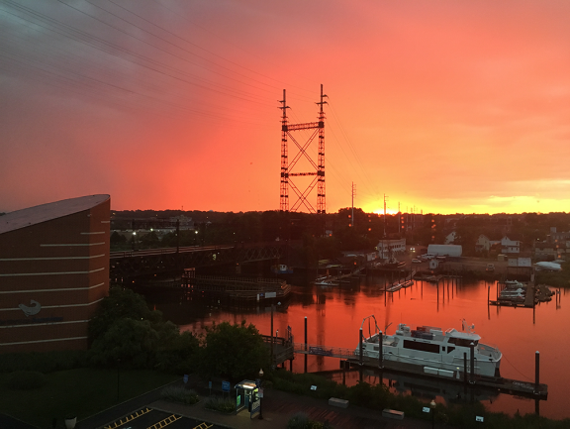
Image Fundamentals
Pixels
Total Pixels : 1000 X 750
750 pixels
column : 1000
row : 750
1000 pixels

Slide 7

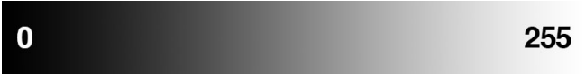
Image Fundamentals
Grayscale/Single Channel
각 pixel은 0~255 scalar value
BlACK
WHITE

Slide 8
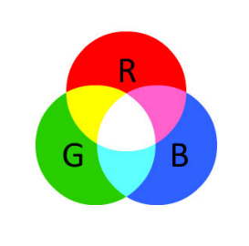
Image Fundamentals
Color (RGB)
ㆍ3가지 값으로 구성
ㆍ각 음영에 대해 0 ~ 255 정의된 값

Slide 9


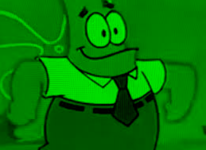

Image Fundamentals
RGB Image conceptualization
폭과 높이의 세개의 독립적인 행렬
W × H × D ( W : width , H : height , D : depth)

Slide 10
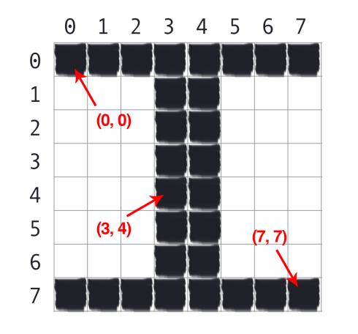
Image Fundamentals
Image Coordinate System
Column
Height
Row
Width

Slide 11
Image Fundamentals
Scaling and Aspect Ratios

Slide 12
Image Fundamentals
Scaling and Aspect Ratios
Center crop
Ignore ratio

Slide 13
Image Classification Basics

Slide 14


Image Classification Basics
What is Image Classification?
Mountain
Input Image
Label

Slide 15
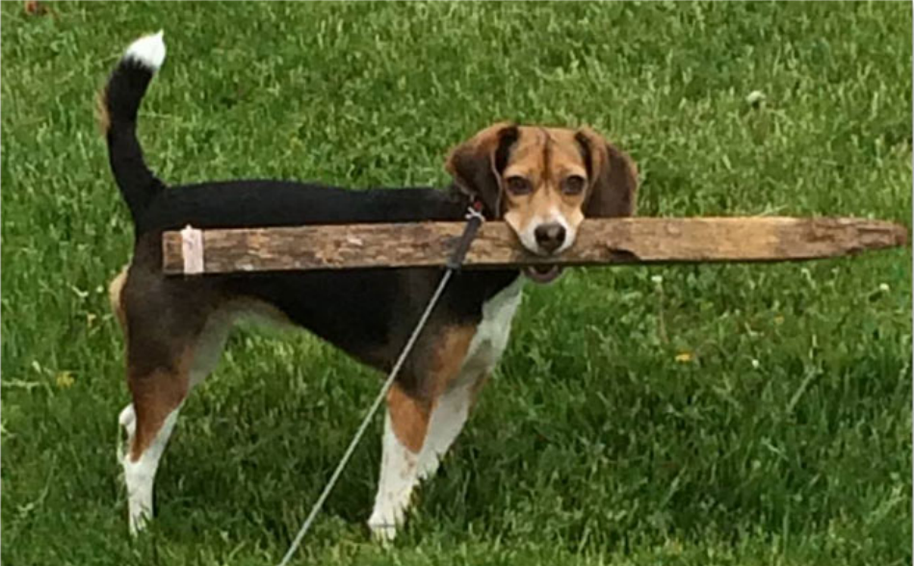
Image Classification Basics
What is Image Classification?
Categories = {cat, dog, panda}
DOG
Dog : 95% , Cat : 4% , Panda : 1%

Slide 16
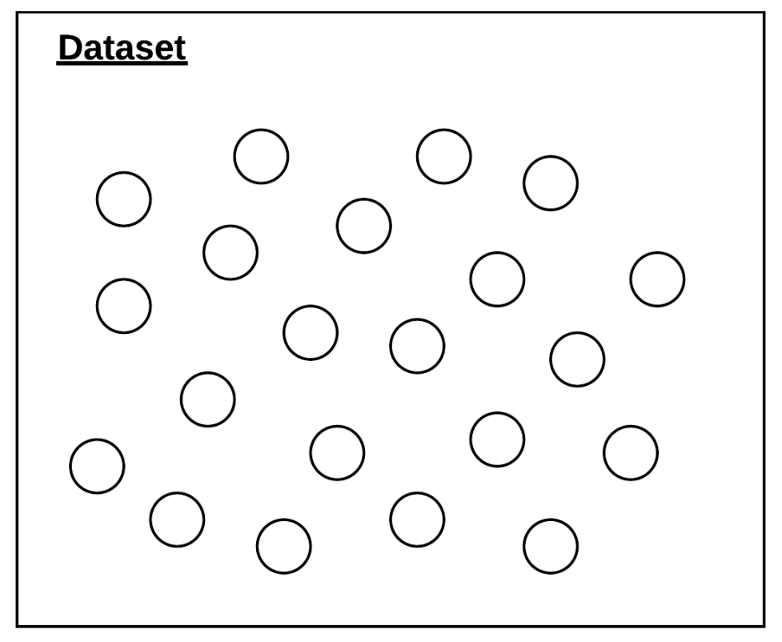
Image Classification Basics
What is Image Classification?
Dataset : Collection of Images
Data Point(Circle) : Image

Slide 17
Image Classification Basics
What is Image Classification?
GOAL
Machine Learning & Deep Learning Algorithm을 적용해 Dataset의
기본패턴을 찾아내고, Algorithm이 경험하지 못한 Data Point를 정확하게 분류

Slide 18
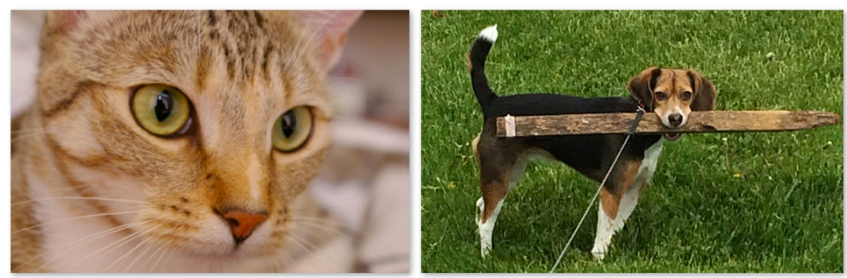
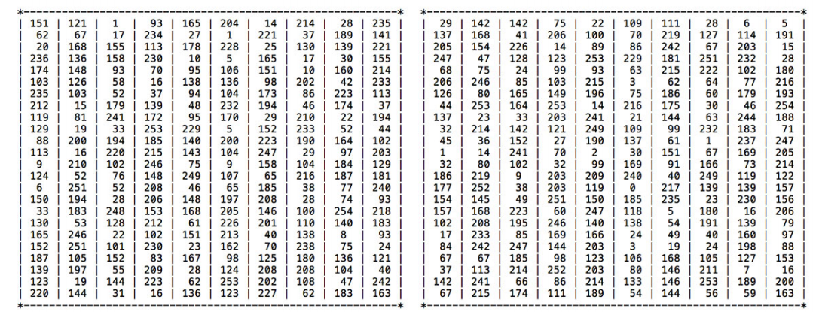
Image Classification Basics
The Semantic Gap

Slide 19
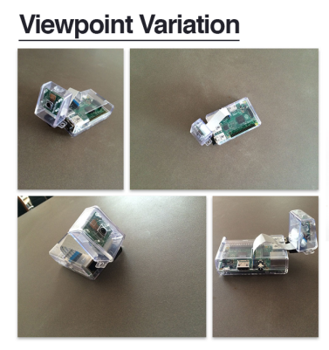
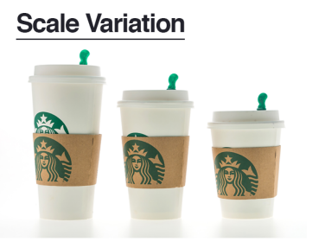
Image Classification Basics
The Semantic Gap
Semamtic Gap 이 문제를 충분히 해결하지 못 할 경우

Slide 20
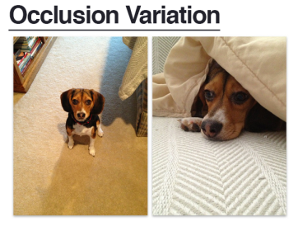
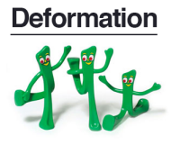
Image Classification Basics
The Semantic Gap
Semamtic Gap 이 문제를 충분히 해결하지 못 할 경우

Slide 21
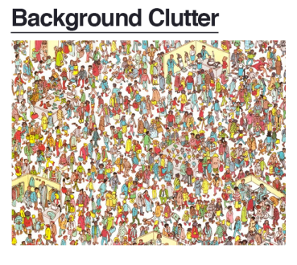
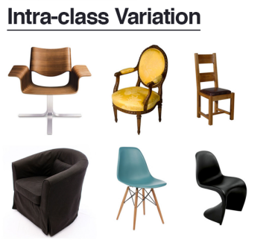
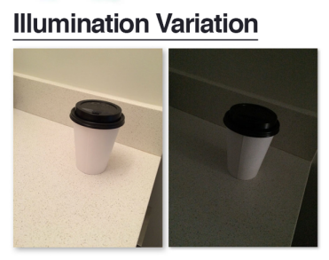
Image Classification Basics
The Semantic Gap
Semamtic Gap 이 문제를 충분히 해결하지 못 할 경우

Slide 22


Image Classification Basics
Types of Learning : Supervised Learning
Education
ML
Label
TEST SET
Test
Training set

Slide 23
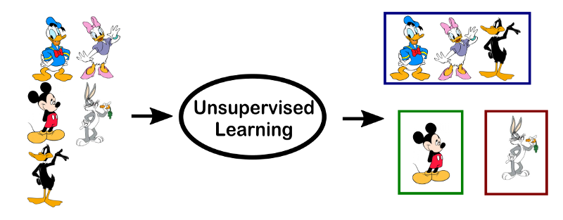
Image Classification Basics
Types of Learning : Unsupervised Learning

Slide 24





Image Classification Basics
Types of Learning : Semi-supervised Learning
CAT
?
DOG
RABBIT
?

Slide 25
Image Classification Basics
Deep Learning Classification Pipeline
Dataset 수집
Dataset 분할
네트워크 교육
평가

Slide 26
Image Classification Basics
Deep Learning Classification Pipeline : Step1 Gather Your Dataset
Label1 : 1000
Label2 : 1000
각 라벨의 이미지 수는 대략적으로 균일해야 함

Slide 27
Image Classification Basics
Deep Learning Classification Pipeline : Step2 Split Your Dataset
Training Dataset
Initial Dataset
Test Dataset

Slide 28
Image Classification Basics
Deep Learning Classification Pipeline : Step3 Train Your Network
IMAGE
Training
NETWORK

Slide 29

Image Classification Basics
Deep Learning Classification Pipeline : Step4 Evaluate

Slide 30
Datasets for Image Classification

Slide 31
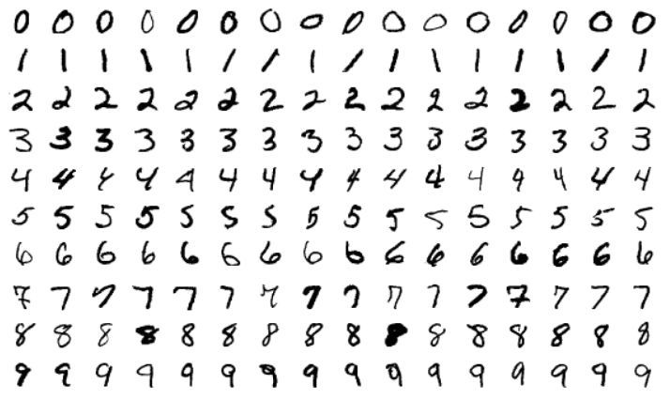
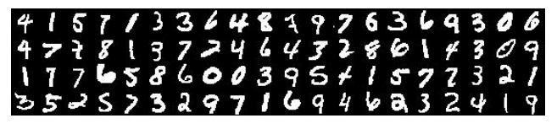
Datasets for Image Classification
MINST(Modified National Institute of Standards and Technology)

Slide 32
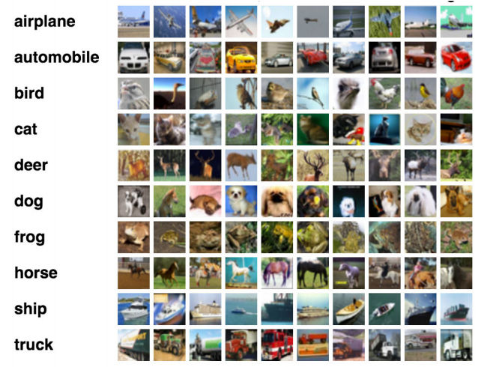
Datasets for Image Classification
CIFAR-10

Slide 33
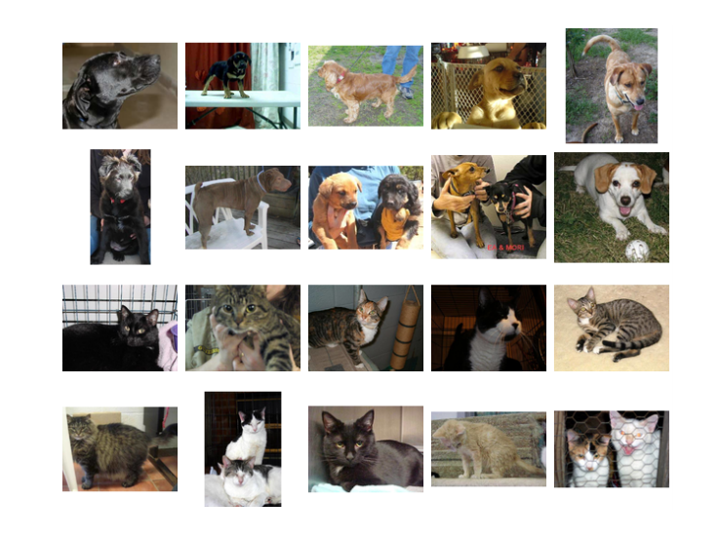
Datasets for Image Classification
Kaggle : Dogs vs Cats

Slide 34
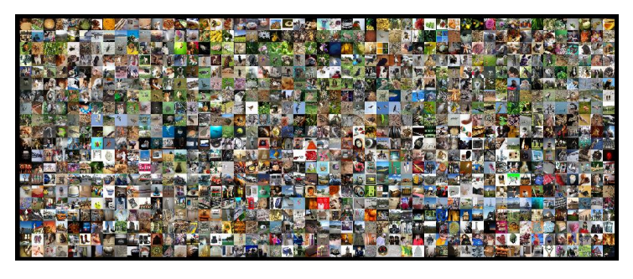
Datasets for Image Classification
ImageNet

Slide 35
Your First Image Classifier

Slide 36
Your First Image Classifier
Working with Image Datasets : Basic Image Preprocessor
k-NN , SVMS, CNN 등 알고리즘은 dataset의 모든 이미지를 고정된 기능 벡터의 크기를 가져야함

Slide 37
Your First Image Classifier
Working with Image Datasets : Image Loader
/dataset_name/class/image.jpg
계층적 디렉터리 구조 -> dataset을 깔끔하고 체계적으로 유지 가능

Slide 38
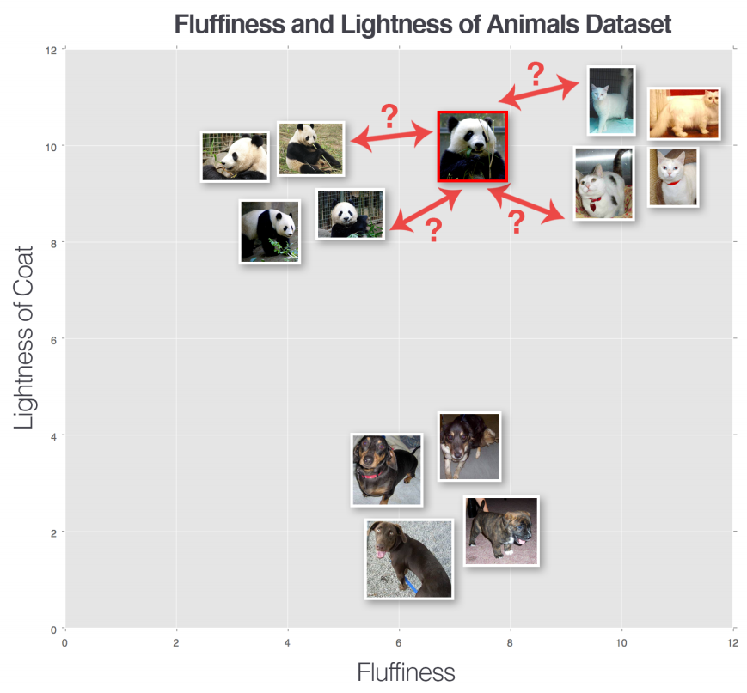
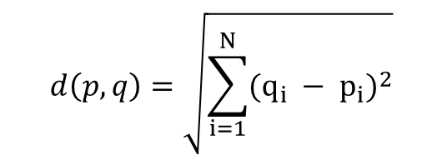
Your First Image Classifier
k-NN(k-Nearest Neighbor) : A Simple Classifier
Unknown Data
Panda? Cat?
Uclidean distance
$$ⅆ\left(p,q\right)=\sqrt{\sum_{i=1}^{N}{{(q_{i} − p_{i})}^{2}}}$$

Slide 39
Your First Image Classifier
k-NN(k-Nearest Neighbor) : Hyperparameter
① k의 최적값
② 실제 거리 측정 기준

Slide 40
Your First Image Classifier
k-NN(k-Nearest Neighbor) Advantage & Disadvantage
ㆍ장점 : 구현 및 이해 간단, 저차원 공간에 적합
ㆍ단점 : dataset scale ↑ → 까다로워짐
스스로 개선, 수정 X → 실제로 학습 X

Slide 41
Parameterized Learning

Slide 42
Parameterized Learning
Linear Classification : Four Components of Parameterized Learning
“
“
“
“
입력 데이터
Data
레이블에 매핑된 점수
Score Function
오류를 줄여주는 함수Loss Function
분류 정확도를 높이기 위한 값
Weight and Biases
”
”
”
”

Slide 43
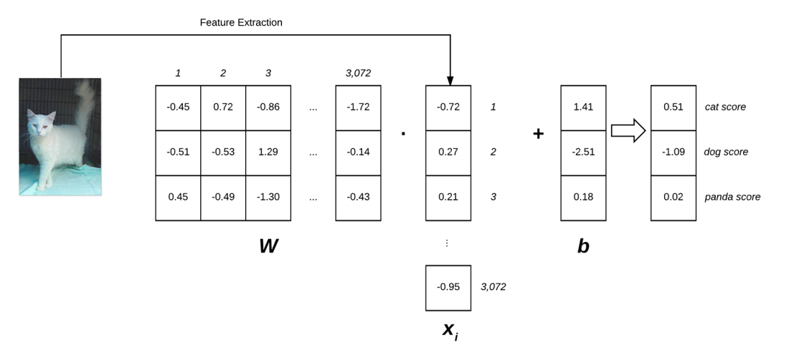
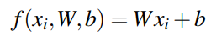
Parameterized Learning
Linear Classification

Slide 44
Parameterized Learning
Linear Classification
① 모델 Training 종료 후 W와 b 만 유지 가능
② Test Data 분류하는 속도가 빠름

Slide 45
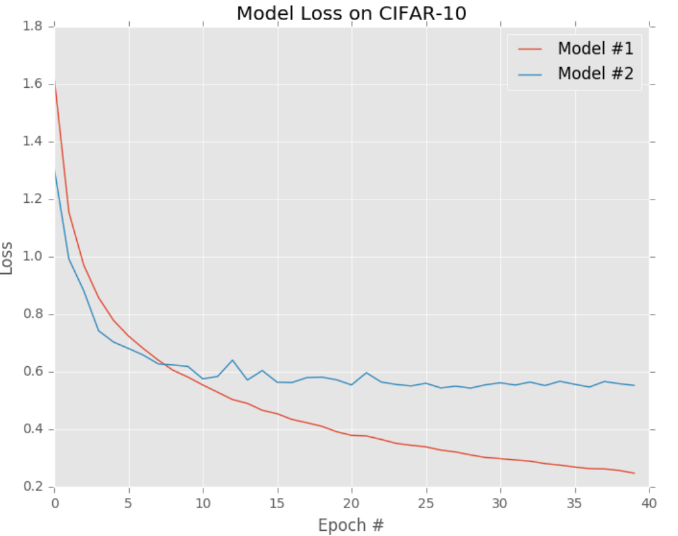
Parameterized Learning
Loss Function

Slide 46
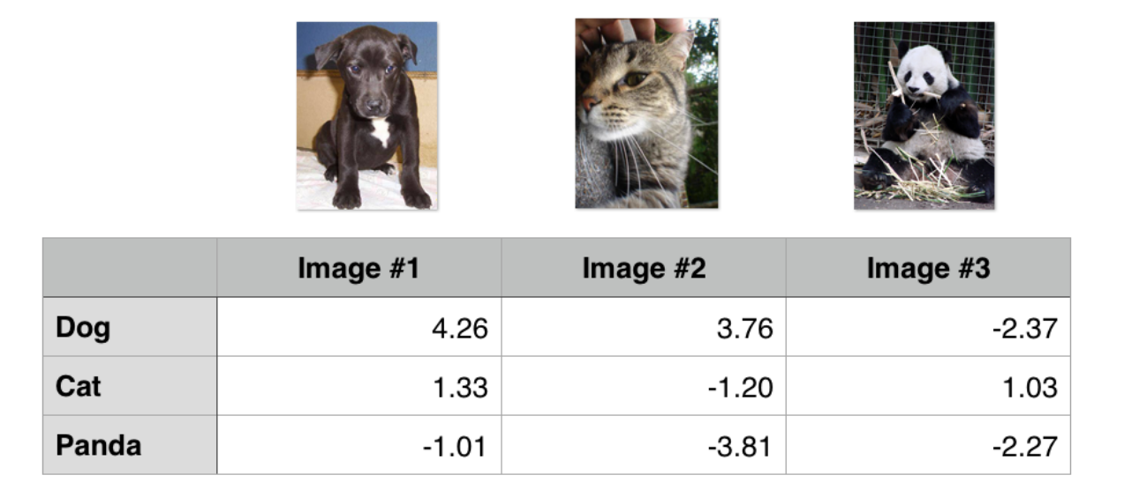
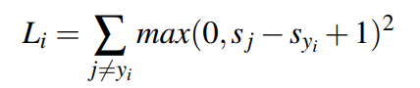
Parameterized Learning
Loss Function : Multi-class SVM(Support Vector Machines)
Hinge Loss Function

Slide 47
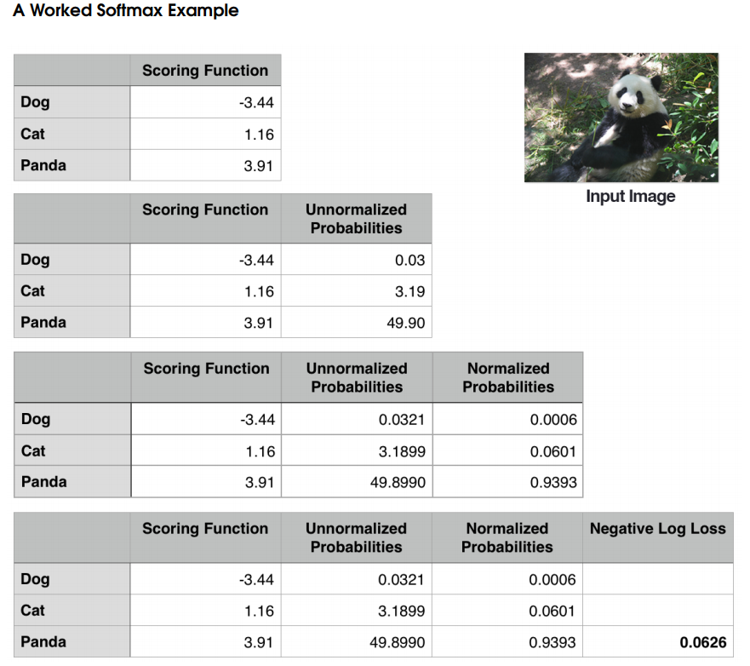
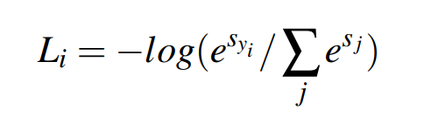
Parameterized Learning
Loss Function : Multi-class SVM(Support Vector Machines)
Cross-entropy Loss

Slide 48
Optimization
Methods and Regularization

Slide 49
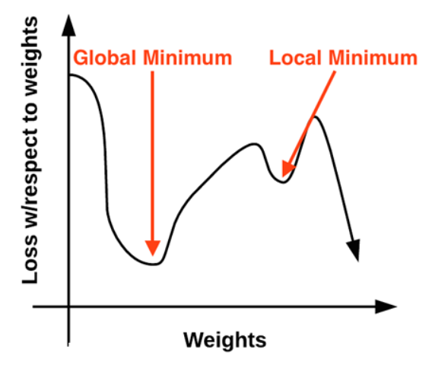
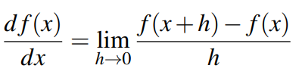
Optimization Methods and Regularization
Gradient Descent

Slide 50
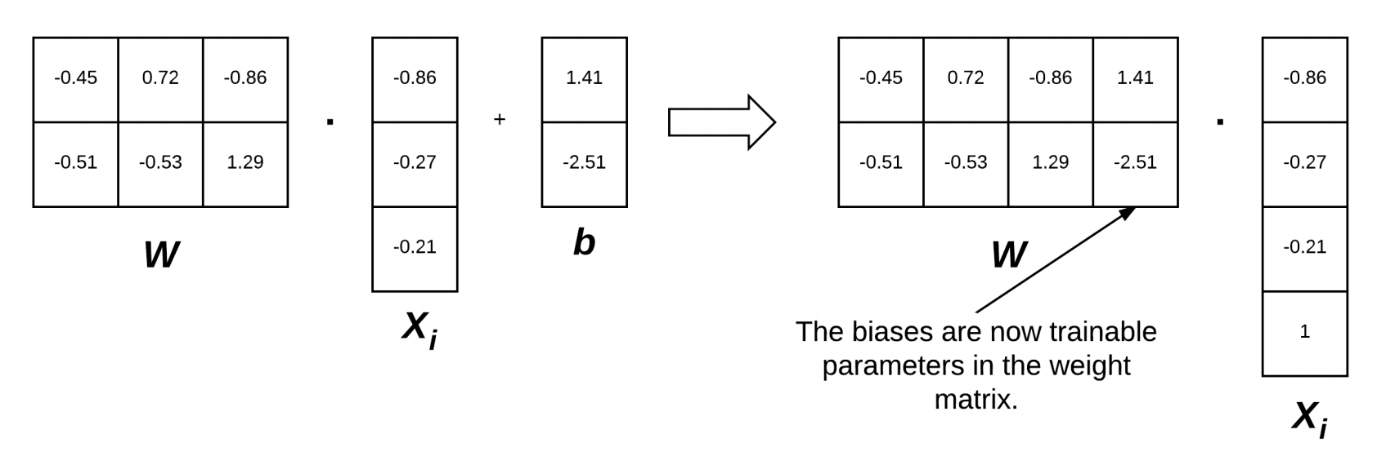
Optimization Methods and Regularization
Gradient Descent : The Bias Trick

Slide 51
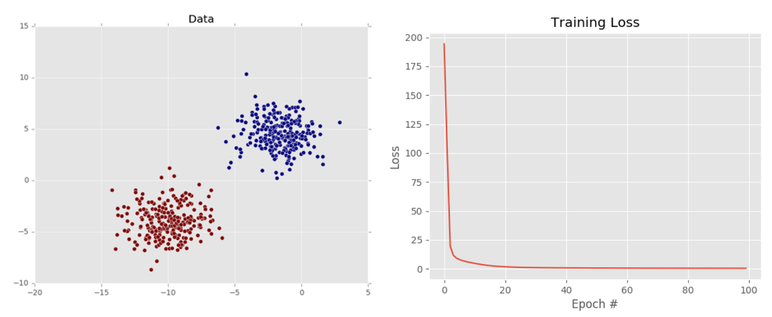
Optimization Methods and Regularization
Gradient Descent

Slide 52
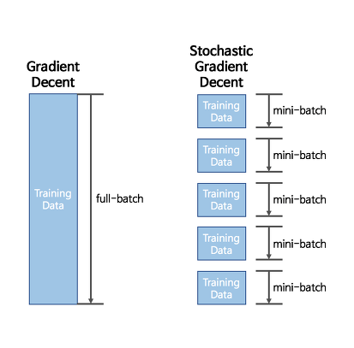
Optimization Methods and Regularization
Stochastic Gradient Descent : Mini-batch SGD
Batch 크기에 따라 업데이트
Batch 크기 : 1(SGD), 32, 64, 128, 256

Slide 53
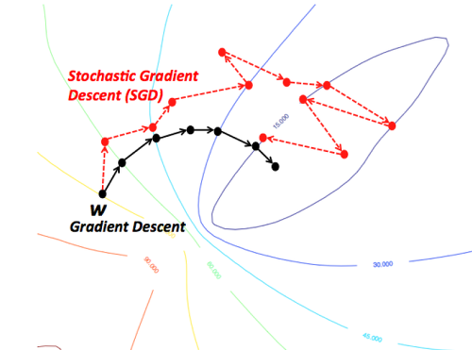
Optimization Methods and Regularization
Stochastic Gradient Descent : Mini-batch SGD
ㆍGD
모든 데이터를 계산 → 소요시간 1시간
최적의 한 스텝 나아감
6 스텝 * 1시간 → 6시간
→정확성↑ but very slow
ㆍSGD
일부 데이터만 계산 → 소요시간 5분
빠르게 전진
11 스텝 * 5분 → 55분
→ 조금 헤맴 but fast

Slide 54
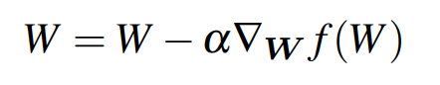
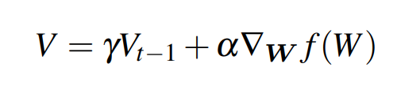
Optimization Methods and Regularization
Extensions to SGD : Momentum
모멘텀? 기울기 + 속도
γ에 의해 확장된 모멘텀 V

Slide 55
THANK YOU!
감사합니다

